Slide 1
Teachers' unions in the Balkans for peace – policies of the Education, Science and Culture Trade Union of Slovenia (SVIZ)
Sofia, March 25th, 2016

Slide 2
The Principles and Objectives of ESTUS, adopted at the congress in 1998
We, the members of the Education, Science and Culture Trade union of Slovenia, believe that solidarity between people is a key precondition for successful promotion of the interests of employees in education and research, for protection of our dignity and increase of reputation of the profession we are representing. We speak of solidarity with individuals whose rights and human dignity are at stake, equality, solidarity between different professions and levels of education, solidarity between employees at different levels in education and research. Solidarity unites us and makes us stronger. We will actively participate in public debates, especially those relating to education and science, to human rights, fundamental freedoms and social issues.
We oppose and will oppose all forms and appearances of intolerance, especially racism, xenophobia, and anti-semitism in the broadest sense of word. We insist that public education is a right that a country should provide for to each child. Only public education provides children of both sexes equal opportunities for education irrespective of the financial situation, social or ethnic origin of their parents … Public education contributes to the reduction of inequalities in society and increases cooperation and by that contributes to more balanced development of the society. Education of children in the context of public education - without any discrimination – helps young people to be able to accept differences and promotes respect for the other and the different.

Slide 3
SVIZ – committed to promotion of peace and solidarity

Slide 4
Our first letter to the Ministry

Slide 5
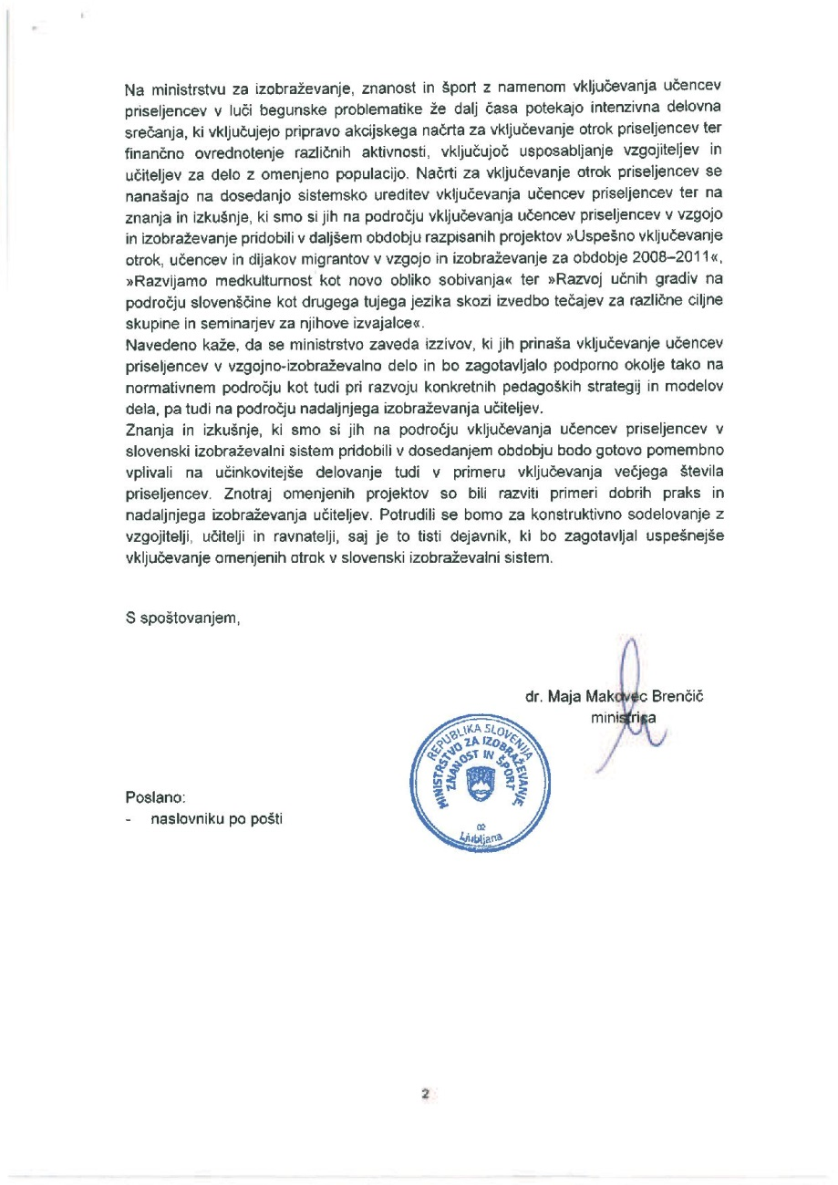
… and their reply

Slide 6
Our public statement

Slide 7
„Migrants not welcome“

Slide 8
„Slovenia against migrant centers“

Slide 9
24 signatures

Slide 10
„I am a refugee as well; running from xenophobia.“

Slide 11
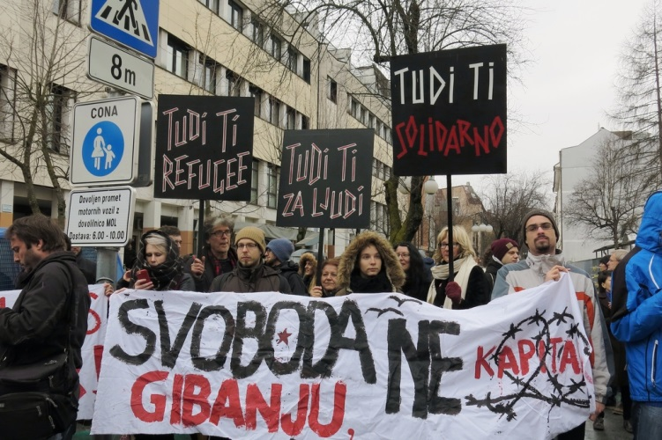
„For the freedom of movement“

Slide 12
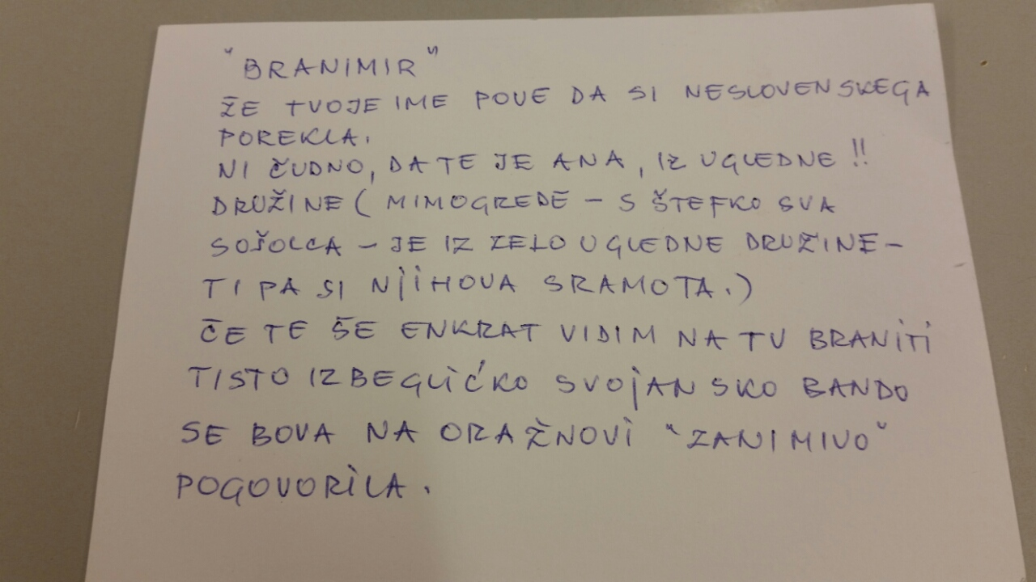
Anonymous letter(s)

Slide 13
„No room for racists!“

Slide 14
For a better tomorrow of all!

Slide 15
Thank you for your attention!

